Slide 1




Experiences in Using a MOOC to Support Teacher Professional Development of a New AP Course in Computer Science
26th SITE 2015 Conference
Las Vegas, March 3rd 2015
Mokter Hossain
Jeff Gray
Department of Computer Science
University of Alabama
Tuscaloosa-35487

Slide 2

Experiences in Using a MOOC to Support Teacher Professional Development of a New AP Course in Computer Science
Outline of the Presentation
Introduction
MOOCs and their Popularity
Google’s Course Builder and App Engine
Background of the Study
Procedure
Research Questions
Findings and Discussion
Suggestions for MOOC Developers
Implications of the Study
Conclusions
Acknowledgement

Slide 3
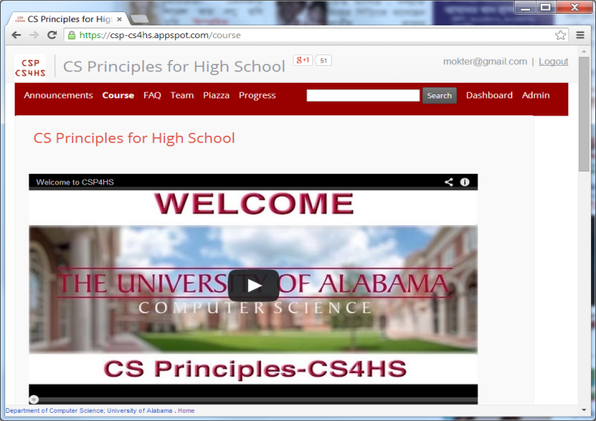
Experiences in Using a MOOC to Support Teacher Professional Development of a New AP Course in Computer Science
Introduction
The AP Computer Science and CS Principles Course
  A new College Board AP Exam
The MOOC came from the CS4Alabama Project, mainly to support the geographic needs among teachers distributed across Alabama
Google CS4HS provided support to take this nationally
The Course’s Home Page is:
  https://csp-cs4hs.appspot.com

Slide 4
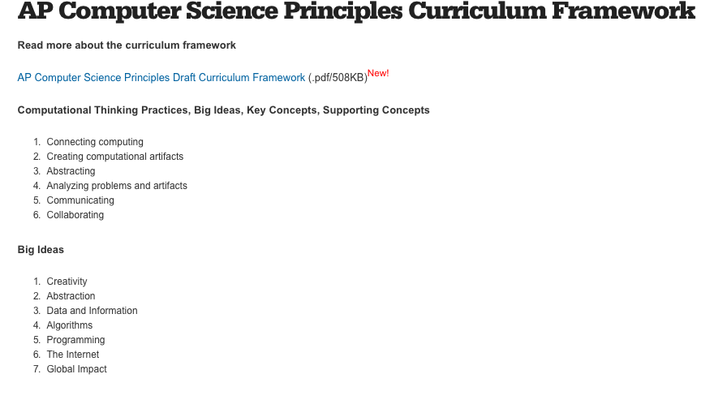
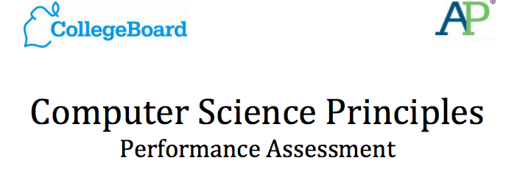
Designed, multi-year, iterative development
Big Ideas (7)
Computational Thinking Practices (6)
Enduring Understandings (23)
Learning Objectives (42)
Essential Knowledge Statements (300+)
Notes:
ECS: (Goode, Chapman, Margolis, 2012; Goode, Margolis, 2011)
Current curriculum development and piloting efforts, targeted towards Middle School CS, are rapidly taking the stage (e.g., Panoff’s keynote address, SIGCSE, 2014).

Slide 5
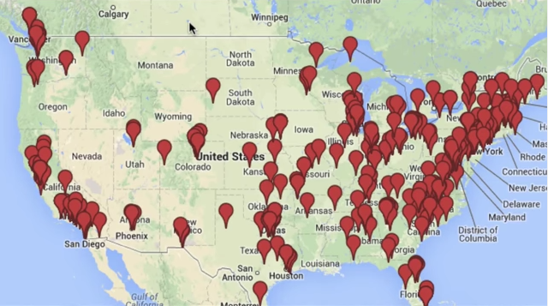
Locations of Instructors Piloting CS Principles
(or interested in teaching CS Principles)

Slide 6
Core Characteristics of CS Principles
7 Big Ideas
  Abstraction, Algorithms, Creativity, (Big) Data, Impact, Internet, Programming,
Two Performance Tasks
  Create, Explore
AP-level rigor (first exam in May 2017)
Deep PD available and curriculum being developed
  NSF CE21, Code.org, PLTW
More Accessible
  Easier to teach for in-service teachers
  Attract more diversity from topic focus (not just a programming course)

Slide 7
Experiences in Using a MOOC to Support Teacher Professional Development of a New AP Course in Computer Science
MOOCs and their Popularity
MOOC- A Massive Open Online Course- is an online course that aims to deliver educational services to a large number of participants, often with free, open, and unlimited access. e.g., Coursera, Udacity, edX, etc.
The year 2012 became “the year of the MOOC”, according to The New York Times
26.5% of US universities; 16.5% of Indian universities; 16.2% of Chinese universities; 3.9% of Canadian, Australian, and UK universities provide MOOCs.

Slide 8
Experiences in Using a MOOC to Support Teacher Professional Development of a New AP Course in Computer Science
Google’s Course Builder and App Engine
Google Course Builder (GCB) is an online course management tool. Google inaugurated it in July 2012.
GCB is an open source online platform that deploys course materials on Google App Engine (GAE).
The App Engine is a cloud computing platform that provides services for developing and hosting web applications in Google-managed data centers.
GAE App Engine offers automatic scaling for web applications.

Slide 9
Experiences in Using a MOOC to Support Teacher Professional Development of a New AP Course in Computer Science
Background of the Study
The CSP4HS MOOC is a professional development course, offered for high school teachers interested in offering the new College Board Computer Science Principles (CSP) course in their classrooms.
Due to several requests by some participants, the duration of our MOOC was extended through mid-Fall.
About 100 YouTube Videos; Associate Curriculum Materials (Slides, Assessments, Lesson Plans)
All of these are freely available to teachers

Slide 10
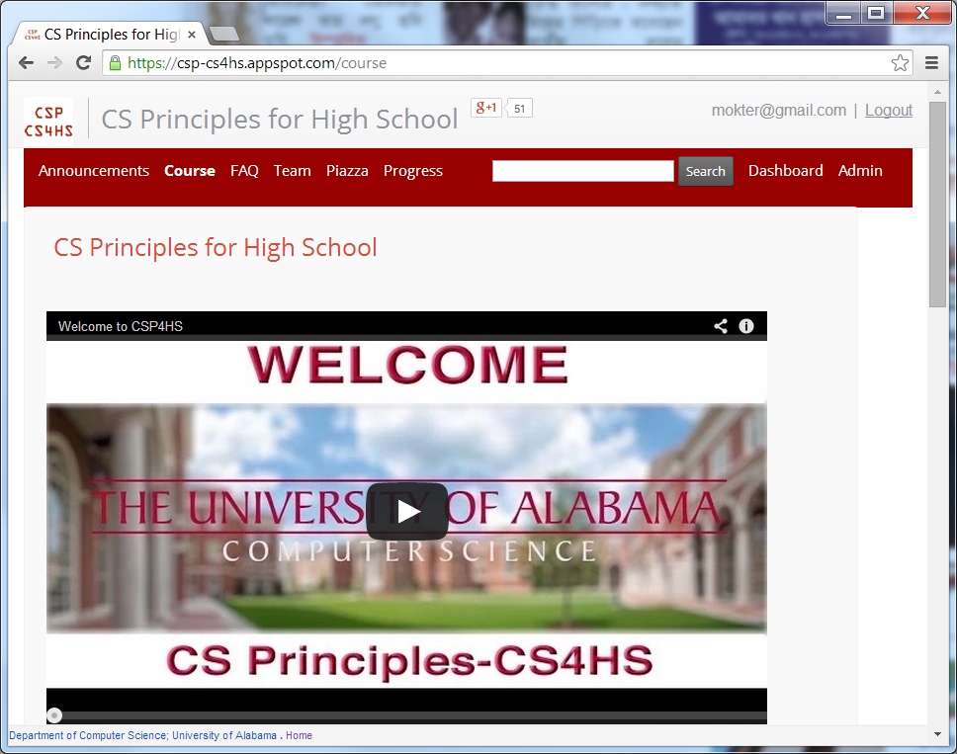
Experiences in Using a MOOC to Support Teacher Professional Development of a New AP Course in Computer Science
Top of the Web Page
https://csp-cs4hs.appspot.com

Slide 11
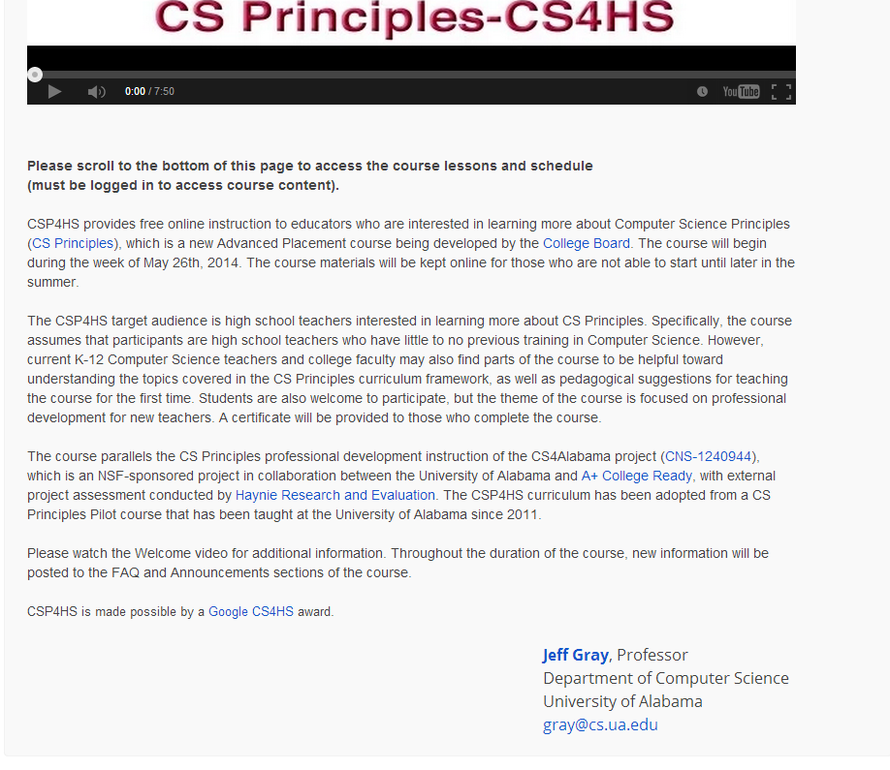
Experiences in Using a MOOC to Support Teacher Professional Development of a New AP Course in Computer Science
Middle of the Web Page
https://csp-cs4hs.appspot.com

Slide 12
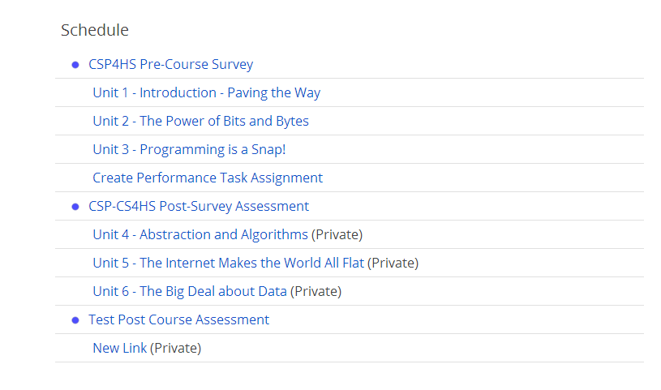
Experiences in Using a MOOC to Support Teacher Professional Development of a New AP Course in Computer Science
Bottom of the Web Page
https://csp-cs4hs.appspot.com

Slide 13
Experiences in Using a MOOC to Support Teacher Professional Development of a New AP Course in Computer Science
Procedure
Before implementing the real course, we deployed a test course to experiment and configure the desired features that we wanted to provide
After deployment the real course, it was monitored continuously
Permission was sought from our university Institutional Review Board (IRB) for conducting pre- and post-surveys with the participants
Both quantitative and qualitative data were retrieved and analyzed for reporting our experience and findings

Slide 14
Experiences in Using a MOOC to Support Teacher Professional Development of a New AP Course in Computer Science
Research Questions
Research question 1: What are the advantages of using Course Builder in designing and implementing a MOOC over a traditional online course management system?
Research question 2: Are there any requirements or open challenges for joining and completing an open online course using Course Builder?
Research question 3: What are the requirements for teachers and researchers in designing and implementing a MOOC on Course Builder?
Research question 4: What are the main challenges in designing and administrating a MOOC and what strategies exist for handling these challenges?

Slide 15
Experiences in Using a MOOC to Support Teacher Professional Development of a New AP Course in Computer Science
Findings and Discussion
Participants’ Information
  There are over 1,150+ participants enrolled in our CS Principles MOOC
  Participants’ Demographic information were collected an optional anonymous Pre-survey. 583 participants completed the Pre-survey
  Participants were from 46 US states and from some other countries including, Australia, Bangladesh, Canada, China, India, Spain, France, Germany, Nigeria, Paraguay, Singapore, and South Korea
  About 73% were public high school teachers, 20% were private school teachers
Table – 1. Participants’ teaching level by school type cross tabulation
School Type → ----------------------------------- Teaching Level ↓ |  | Public School | Private School | Charter School | After school program | null | Total
Elementary | 0 | 4 | 3 | 0 | 1 | 0 | 8 (1.4%)
Middle School | 0 | 33 | 18 | 0 | 3 | 2 | 56 (9.5%)
High School | 0 | 341 | 77 | 12 | 0 | 3 | 433 (73.6%)
Post-Secondary | 1 | 29 | 9 | 1 | 0 | 0 | 40 (6.8%)
Currently not Teaching | 0 | 19 | 6 | 1 | 4 | 11 | 41 (7%)
Null | 0 | 4 | 2 | 0 | 0 | 4 | 10 (1.7%)
Total | 1 | 430 (73.1%) | 115 (19.6%) | 14 (2.4%) | 8 (1.4%) | 20 (3.4%) | 588

Slide 16
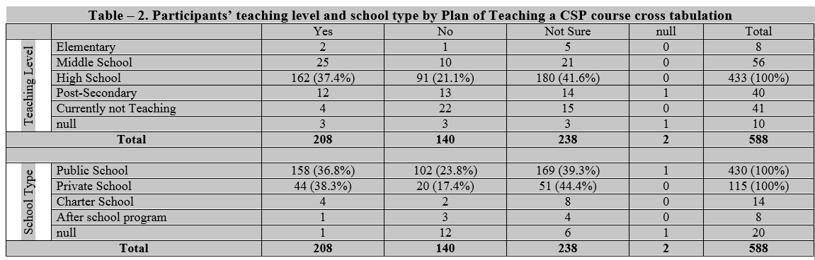
Experiences in Using a MOOC to Support Teacher Professional Development of a New AP Course in Computer Science
Findings and Discussion…
Participants’ Information…
  Among the high school teachers, more than 37.4% were currently teaching a CSP course. Moreover, about 41.6% were not sure but might be teaching a CSP course in the near future.
  Among the public and private school teachers, these rates were about 36.8% and 39.3%; and 38.3% and 44.4%, respectively.

Slide 17
Experiences in Using a MOOC to Support Teacher Professional Development of a New AP Course in Computer Science
Findings and Discussion…
In the course schedule, there is a post-survey that is still up. However, we have found a Number of Advantages of Using GCB and GAE:
Developers do not require a deep programming background
In order to join and complete an open online course, a participant does not need to have any programming knowledge unless that is required for the course itself
However, the developer and each participant must have a Gmail address or at least a Google credential email address
Cost effective for the developers. Open, free, and 24/7 accessibility for the MOOC participants

Slide 18
Experiences in Using a MOOC to Support Teacher Professional Development of a New AP Course in Computer Science
Findings and Discussion…
GCB and GAE have a Number of Advantaged features. Such as:
Adding and editing a New Course, Unit, Lesson, Activity, Assessment and/or link is facilitated through a web-based dashboard
Flexible in using formatted texts, links, images, videos, activities, Google Docs, and many other static and dynamic features in a lesson
A Course Builder course can include any number of Units, where any number of lessons and activities can be included in a Unit
Course Builder can be used for designing and delivering any kind of online or blended class

Slide 19
Experiences in Using a MOOC to Support Teacher Professional Development of a New AP Course in Computer Science
Suggestions for the MOOC Developers
Strategies that we adopted when using Course Builder:
First, we started with the the Course Builder wiki page http://code.google.com/p/course-builder/wiki/
Second, we found that Course Builder has some kind of color incompatibility with different browsers. However, those issues were more cosmetic and did not affect the functionality of our course.
Third, we noticed that the GAE can backup selected entries; restore the backed up entries to the same or another App; and delete the selected entries. However, it has no such option to download the any kind of entries directly from the course.

Slide 20
Experiences in Using a MOOC to Support Teacher Professional Development of a New AP Course in Computer Science
Suggestions for the MOOC Developers…
Accessing Course Data from Google App Engine
  The hardest part of the entire process!!
Resources:
https://code.google.com/p/course-builder/
https://cloud.google.com/appengine/docs

Slide 21
Experiences in Using a MOOC to Support Teacher Professional Development of a New AP Course in Computer Science
Implications of the Study
The results of this study have possible implications for researchers, educators, and students regarding the use of MOOCs for synchronous and asynchronous learning
The observations of this study might provide insight for teachers and educators who wish to design and implement an open online course for their students and fellow researchers
Resolving the challenges mentioned in this paper should make Course Builder more usable by teachers and researchers planning to offer their own MOOC
Complexities raised in our development might get attention to the GCB and GAE teams to identify areas of need for future versions of GCB and GAE

Slide 22


Experiences in Using a MOOC to Support Teacher Professional Development of a New AP Course in Computer Science
Additional Content of the Course
We used Piazza to build a community of practice and discussion forum for the participants
We used Google Hangouts on Air (broadcast to all participants) each Friday with well-known members of the CS Principles community We also provided Google Hangouts for supporting office hours
Google Hangouts (5-10 participants) were offered multiple times each week to support office hours with our trained facilitiators
These tools helped to provide a combination of synchronous and asynchronous interaction opportunities

Slide 23
Experiences in Using a MOOC to Support Teacher Professional Development of a New AP Course in Computer Science
Conclusions
MOOCs are impressive and emerging online distance education platforms that have been gaining increased popularity worldwide
GCB and GAE provide an open, free, and 24/7 accessibility for the participants of a MOOC
Some challenges may emerge for first-time adopters
The findings of this study will help prospective educators and researchers in designing and implementing such a MOOC
As more educators design more MOOCs using Course Builder, more interactive and additional features are likely to emerge within this platform

Slide 24
Experiences in Using a MOOC to Support Teacher Professional Development of a New AP Course in Computer Science
Acknowledgement
The work presented in this paper was supported in part by a Google CS4HS grant and an NSF CE21 award (CNS- 1240944).
There was a large number of supporting members behind the development of this MOOC. Our Team Members:
  https://csp-cs4hs.appspot.com/team

Slide 25

Experiences in Using a MOOC to Support Teacher Professional Development of a New AP Course in Computer Science
Thank You

